Slide 1


Sales Forecast Analysis
Dr. Pedro Cadahia Delgado

Slide 2



introduction
Assessment Overview
This presentation demonstrates proficiency in AI-driven sales forecasting through practical application of machine learning techniques to predict future sales performance.
Primary Goal
Technical Focus
Key Deliverables
Develop accurate sales forecasts using AI tools to support data-driven business decisions
Demonstrate end-to-end machine learning workflow from data preprocessing to model development
Provide actionable insights with clear visualizations and forecast accuracy metrics

Slide 3

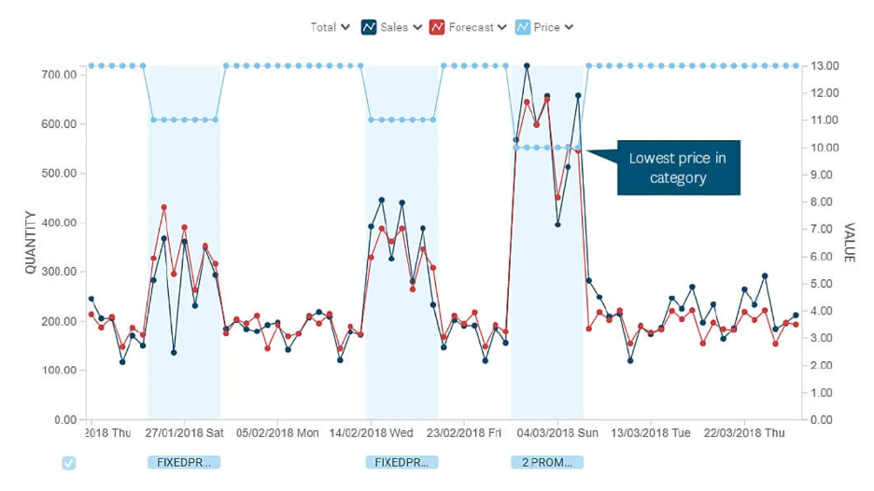



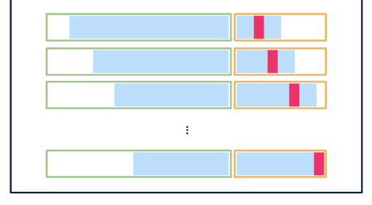

AI Forecasting Methodology
Understand dynamics
Sales demand forecasting model
Output & KPIs
Data
3
Discovery & Scoping
4
5
Data Understanding
Data exploration of data quality to be able to determine limitations, establish further requirements and constrains.
Knowledge discovery analyzing historical sales data, promotional schedules, and pricing changes to uncover patterns, correlations and some causal facts among products, brands, PoS…
Sales are modeled by product with an advanced AI model on available information.
Results can be presented in different granularities (Product, PPG, PoS…)
1
KPIs Traceability: Historical sales volumes, Market share dynamics...
Error Metrics and uncertainty estimation.
Data levers in AI model
Target
Seasonality
Sales
Scope | KPIs | Description
Perfomance | Volume* | Sales units, demand indication.
 | Margin | Profit difference, revenue efficiency.
 | Profit/Value | Net gain, financial performance.
 | RoS | Profitability ratio, sales efficiency.
 | Market Share | Sales dominance, competitive positioning.
Consolidation
Data preparation to maximize data quality, prepare extra features and optimize model performance & interpretability.
2
Impact
Model validation
Data understanding and preprocessing actions aligned with business stakeholders.
Selecting an appropriate model regarding time series complexity.
Backtesting uses a sliding window to test a forecasting model across past periods, ensuring stable errors and reliable predictions.
*Available KPI

Slide 4
Sales Forecast Results
Key Findings
The AI model achieved X% forecast accuracy with strong performance across X product categories. Seasonal patterns and promotional impacts were successfully captured.
Uncertainty estimation shows X… which can impact on some events with under/over stocking.
Forecast shows X% growth in X, driven by holiday campaigns and new product launches.
AVG ACCURACY X %
ACCURACY TABLE
- Opportunity In products/segments
PLOT

Slide 5
Conclusion & Implications
Summary
The AI-powered forecasting approach successfully predicted sales trends with high accuracy, providing reliable insights for strategic planning and resource allocation.
Business Impact
Enables proactive inventory management
Supports data-driven strategic & marketing decisions
Improves budget planning accuracy
Limitations
Assumes stable market conditions
Limited by historical data patterns
Requires continuous model updates
Next Steps
Extend to new products and automated retraining pipelines.
Cross-collaborate with different departments as supply chain, finance… to gather feedback.

